Slide 1

Title: MUMScheduler
SWE PROJECT
Instructor :
Mr. Obinna Kalu
Presented by :
Ayoub Lachhab
Filmon Tesfalem
Zebib Zegherghish
Helen Teklemariam
Anderson Arbelaez Arias

Slide 2
Plan
Problem Statement
III. Class Diagram
IV. System Architecture
VI. DEMO
V. Sequence Diagram
II Use Case

Slide 3
problem statement

Slide 4
Maharishi University of Management has asked you to design and develop a Student Registration System (MUMSched) for their Computer Science department.
The system will enable students to register online for courses each semester, as well as track their progress toward completion of their degree.
When a student first enrolls at the university, he/she uses the MUMSched to create a plan of study that lists the courses he/she plans on taking to satisfy a particular degree program,
and chooses a faculty advisor. The MUMSched system will verify whether or not the proposed plan of study satisfies the requirements of the degree that the student is seeking.

Slide 5
Use case digaram

Slide 6

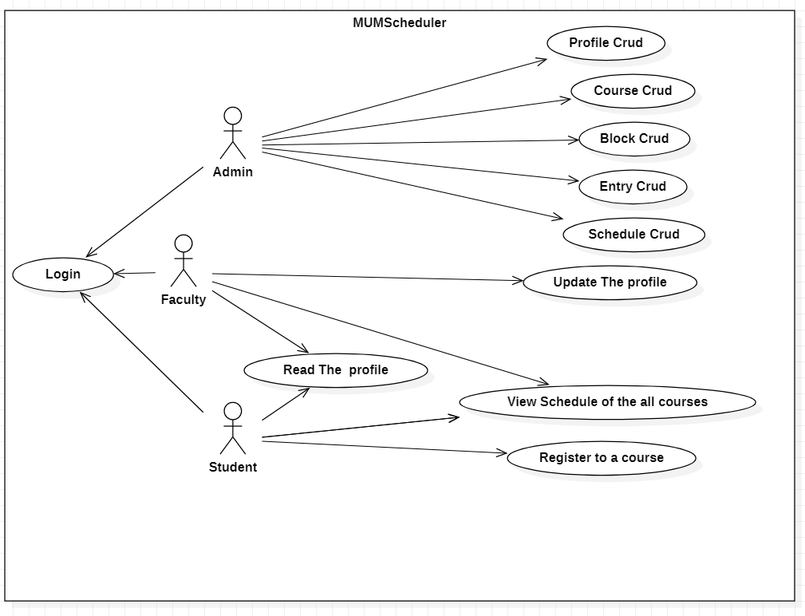

Slide 7
Calss digaram

Slide 8
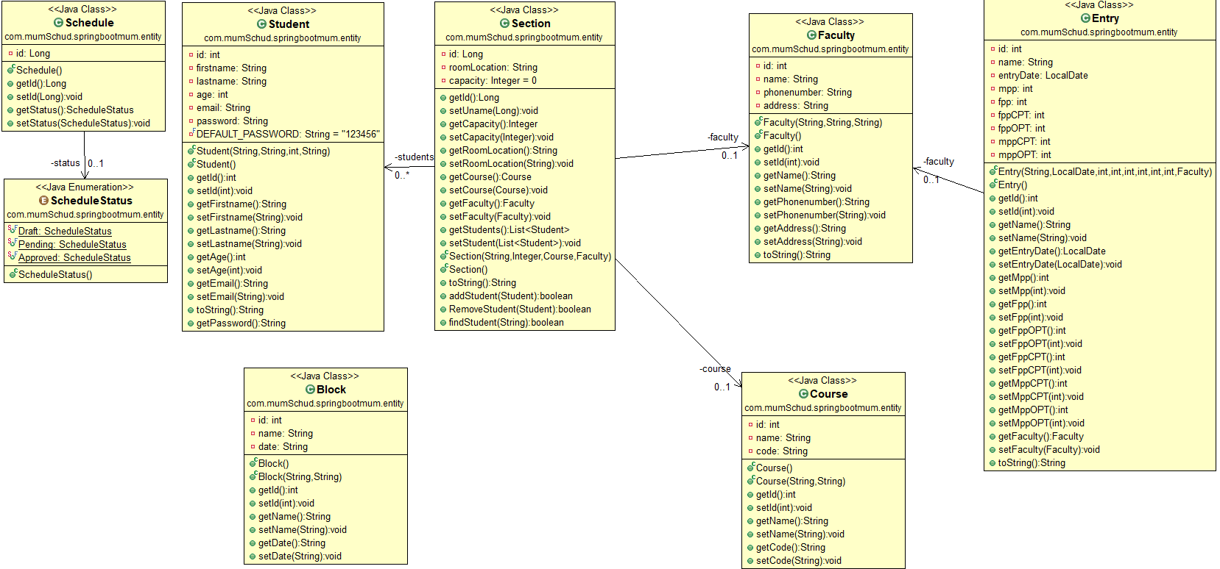

Slide 9
System architecture

Slide 10
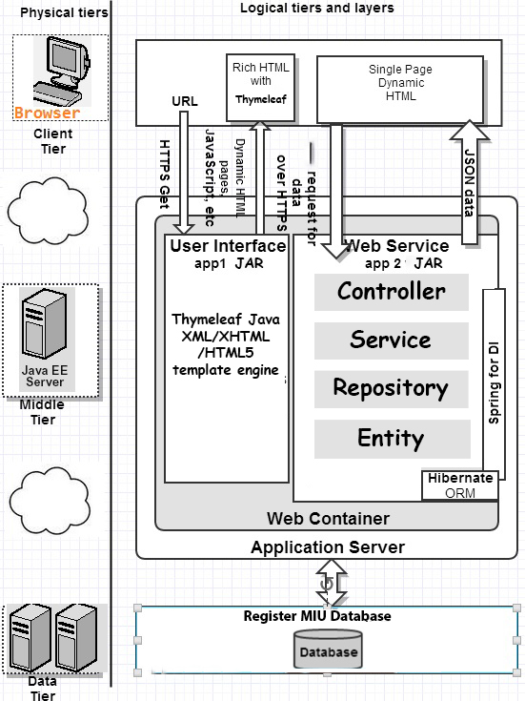

Slide 11
Sequence Diagrams

Slide 12
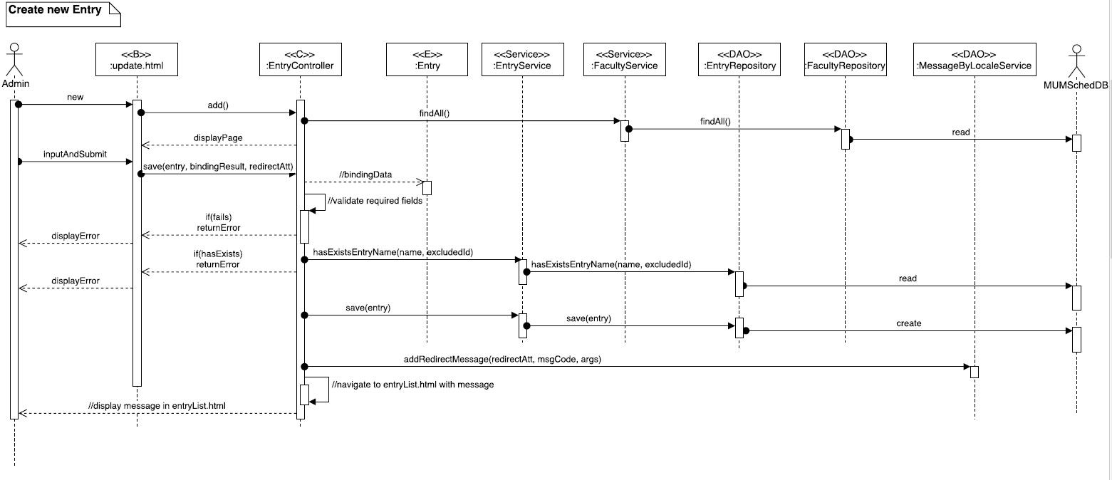

Slide 13
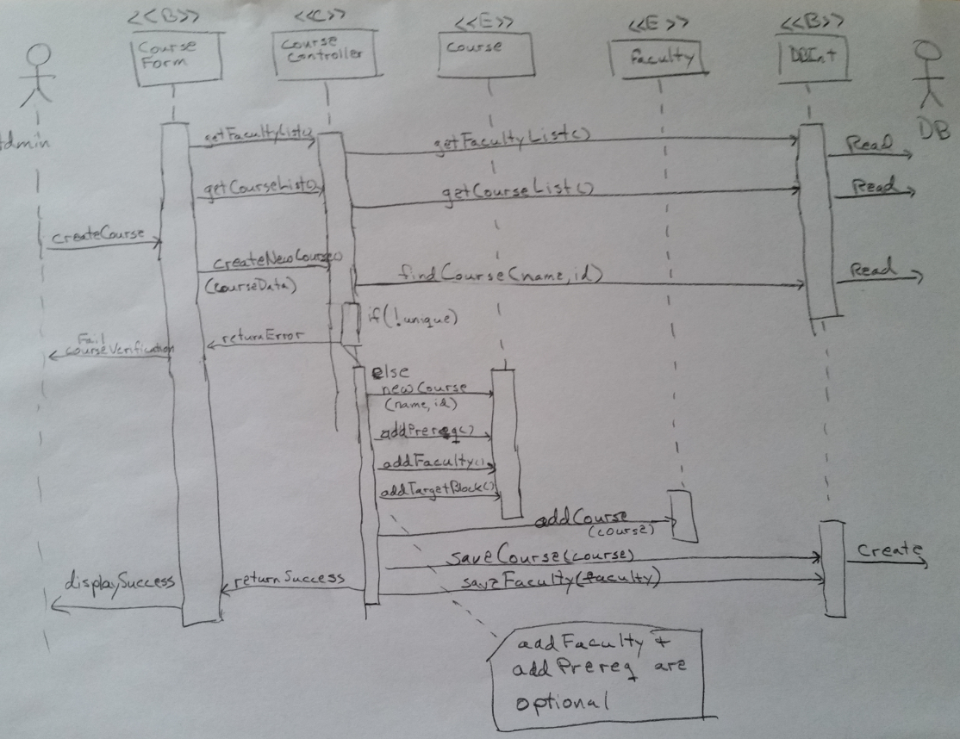

Slide 14
Demo

Slide 15


